Slide 1
CyVerse Tools and Services introduction

Slide 2
CyVerse vision
Transforming science through data-driven discovery
More than 40K users, PBs of data, and hundreds of publications, courses, and discoveries

Slide 3



CyVerse evolution
2006
public launch
2010
2015
2017
funding renewal
iPlant 2008
Empowering a
New Plant Biology
iPlant 2013
Cyberinfrastructure for
Life Sciences
CyVerse 2016
Transforming Science Through Data-Driven Discovery

Slide 4
CyVerse growth: user accounts

Slide 5
CyVerse growth: publications/acknowledgements

Slide 6
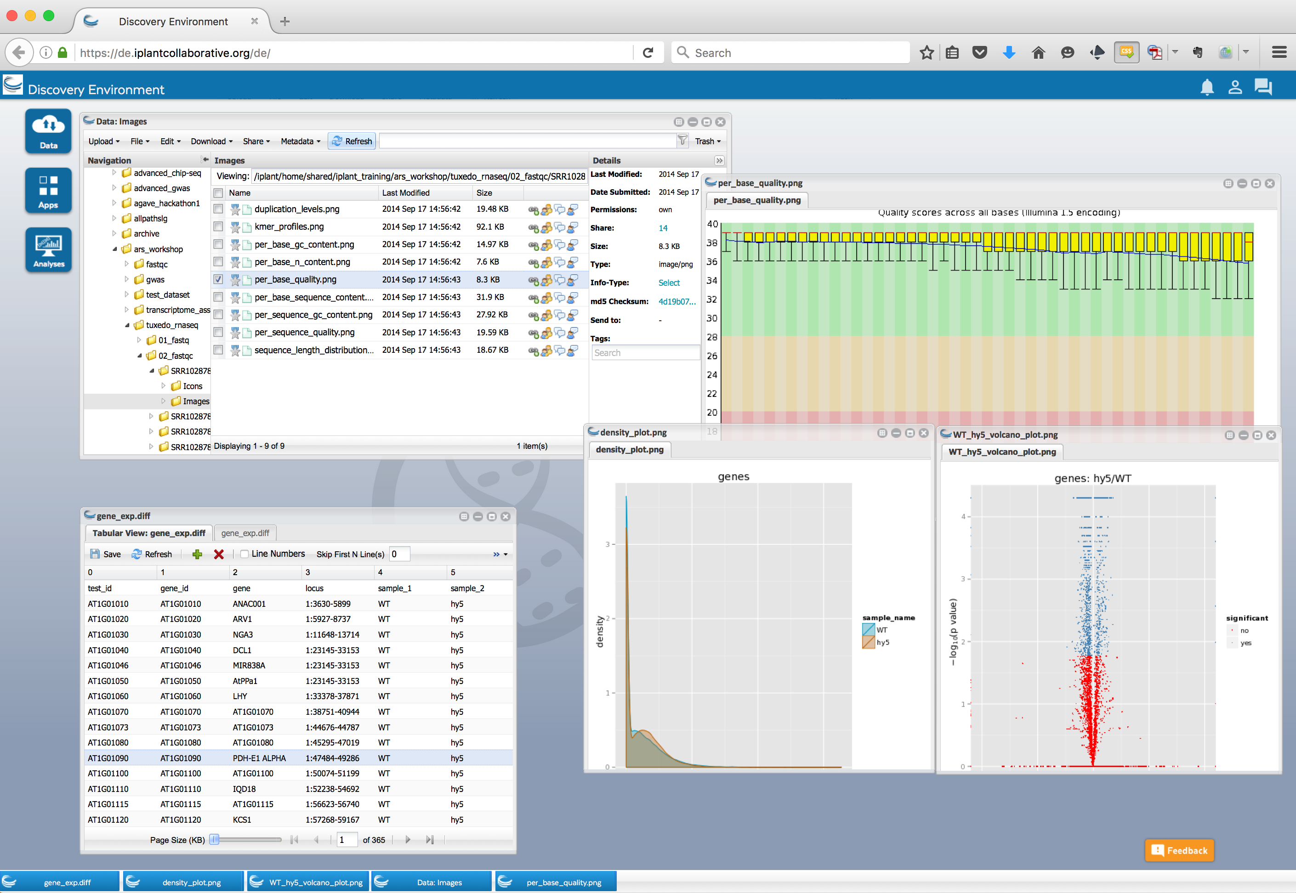
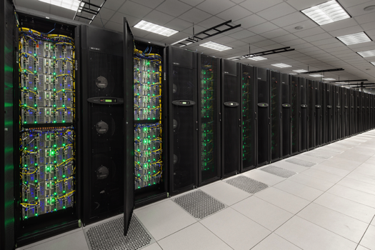
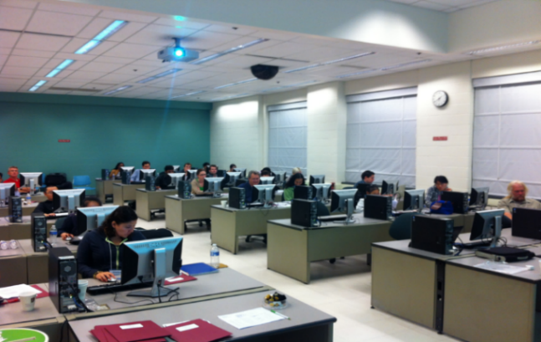
Community-focused cyberinfrastructure
Platforms, tools, datasets Storage and compute Training and support

Slide 7
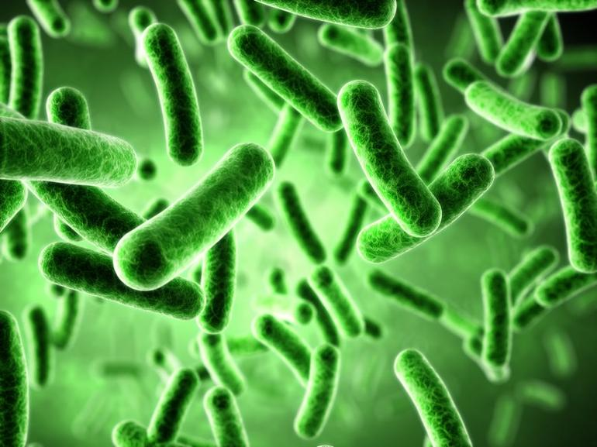

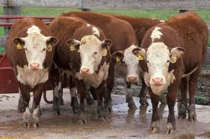


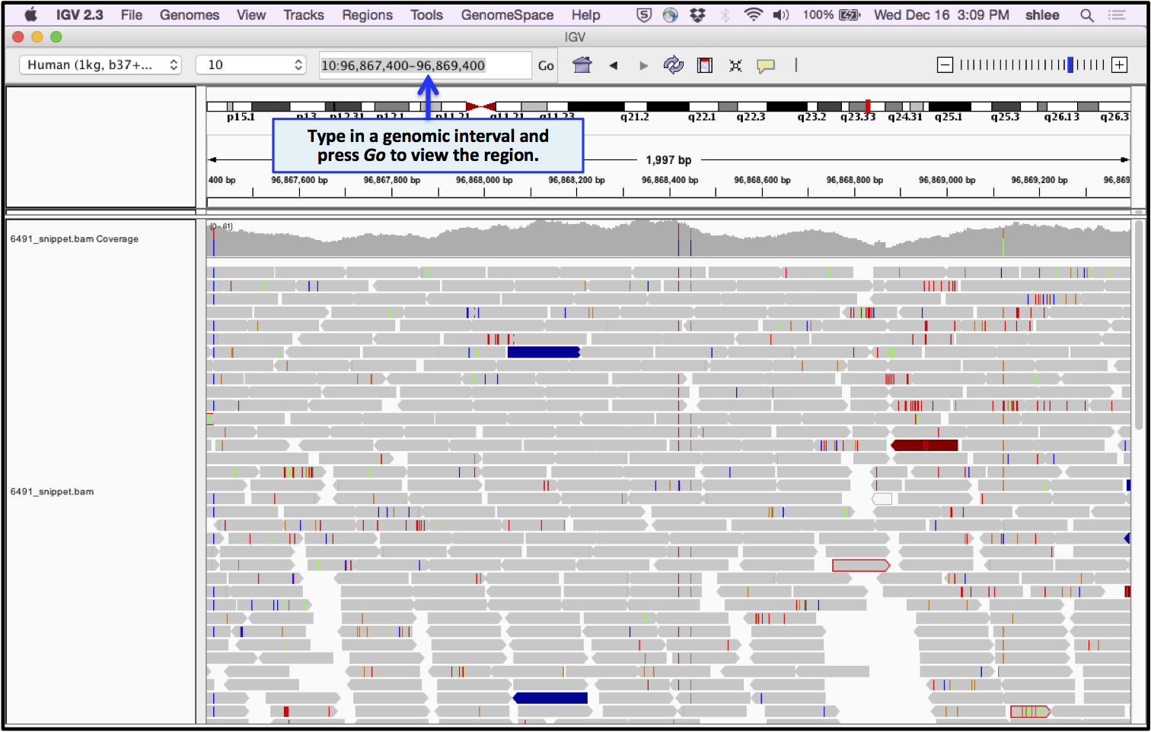
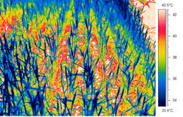
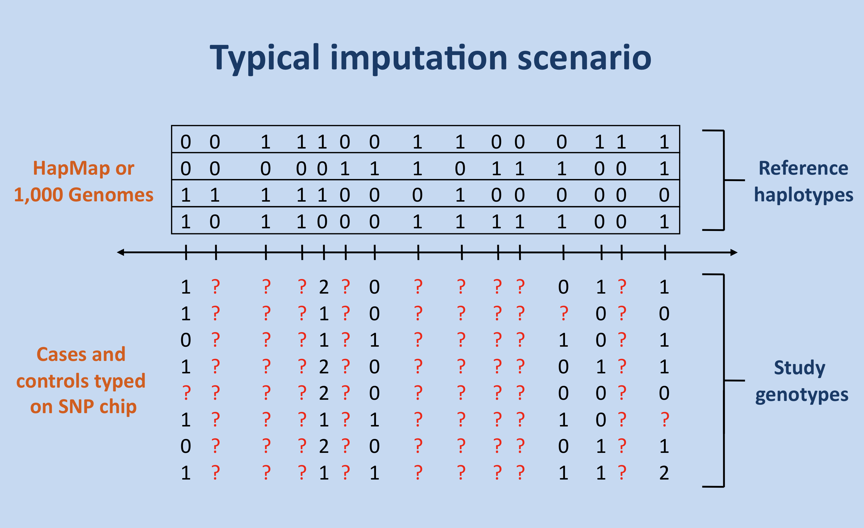
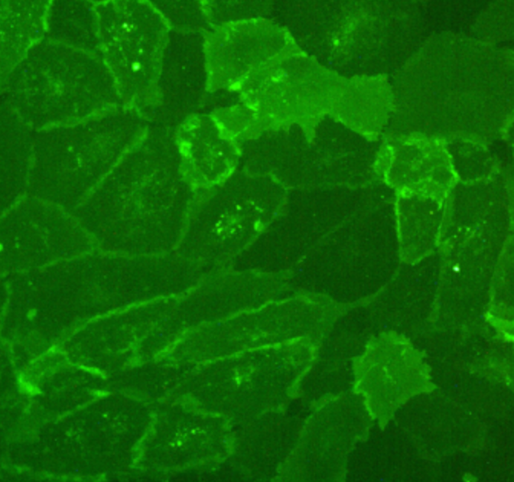
CyVerse is built for data
Microbial Plant Animal Biomedical Ecological
Sequence Images Other datatypes

Slide 8
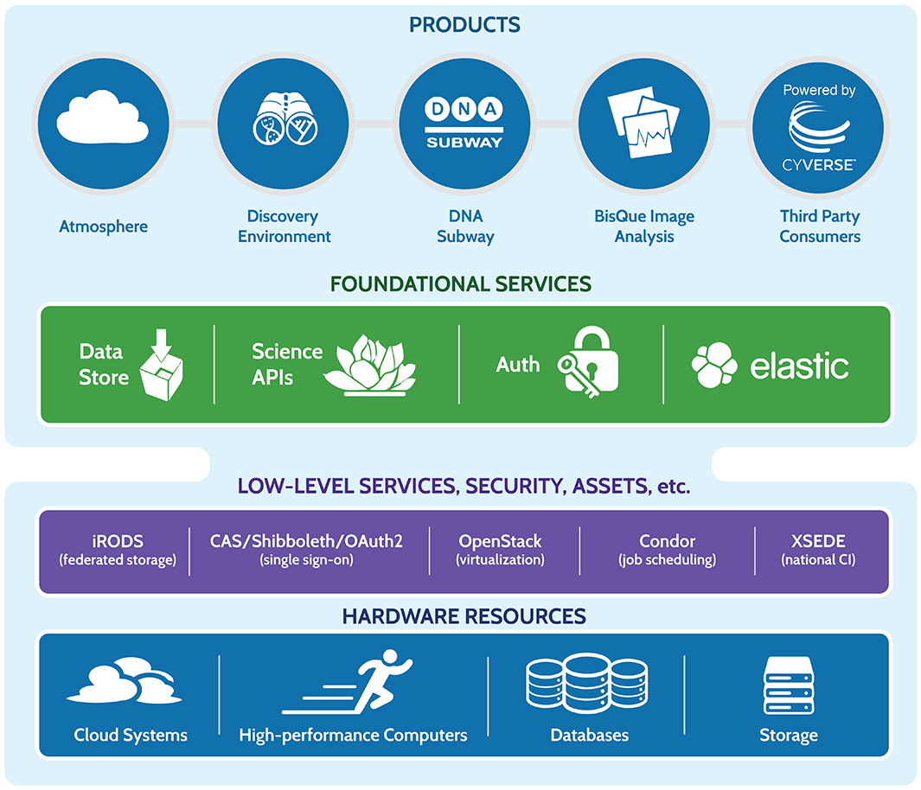
CyVerse product stack
Ready to use Platforms
Extensible Services
Ease of Use
Flexibility
Established CI Components
Foundational Capabilities

Slide 9

Data Store
The resources you need to share and manage data with your lab, colleagues and community
Initial 100 GB allocation – TB allocations available
Automatic data backup
Easy upload /download and sharing
Notes:
Focus here is on genomics data, but not restricted to genomics data

Slide 10
Data lifecycle support
Discovery
Upload
Data Commons Repository (DCR), Elasticsearch
Discovery Environment, iCommands, Cyberduck
Metadata
Publication
Add, delete, copy; metadata templates; bulk metadata
Analysis
Data Commons Repository (DCR), NCBI-SRA
Discovery Environment, Atmosphere, Agave API, BisQue, DNA Subway
Sharing
Community Data folders, Data Commons, quick share links

Slide 11

Discovery Environment
Hundreds of bioinformatics Apps in an easy-to-use interface
A platform that can run almost any bioinformatics application
Seamlessly integrated with data and high performance computing
User extensible – add your own applications
Notes:
Focus here is on genomics data, but not restricted to genomics data

Slide 12
Example Workflows
Sequence Read Processing
Data Publication
HTProcess
SRA Submission
Data Commons
Assembly
Genome
Transcriptome
Variation Analysis
Assembly Analysis
Genome Annotation
Association
Association Pipeline
Validate Pipeline
RNA-Seq
Methylation
Discovery Environment
Atmosphere
Agave API

Slide 13

Atmosphere
Cloud computing for the life sciences
Simple: Access to hundreds of virtual machine images
Flexible: Fully customize your software setup
Powerful: Integrated with CyVerse computing and data resources
Notes:
Focus here is on genomics data, but not restricted to genomics data

Slide 14

Science APIs
Fully customize CyVerse resources
Science-as-a-service platform
Define your own compute, and storage resources (local and CyVerse)
Build your own app store of scientific codes and workflows
Notes:
Focus here is on genomics data, but not restricted to genomics data

Slide 15
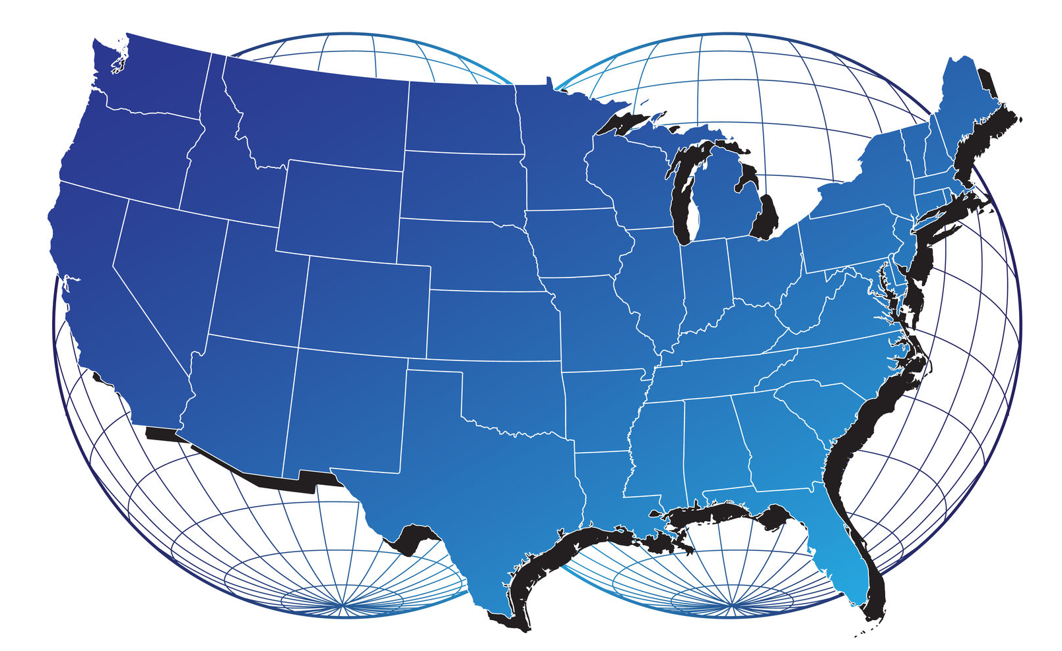
API-enabled federation
CSHL
Powered
by
CyVerse
RENCI
Arizona
TACC
NASA

Slide 16

DNA Subway
Educational workflows for Genomes, DNA Barcoding, RNA-Seq
Commonly used bioinformatics tools in streamlined workflows
Teach important concepts in biology and bioinformatics
Inquiry-based experiments for novel discovery and publication of data
Notes:
Focus here is on genomics data, but not restricted to genomics data

Slide 17
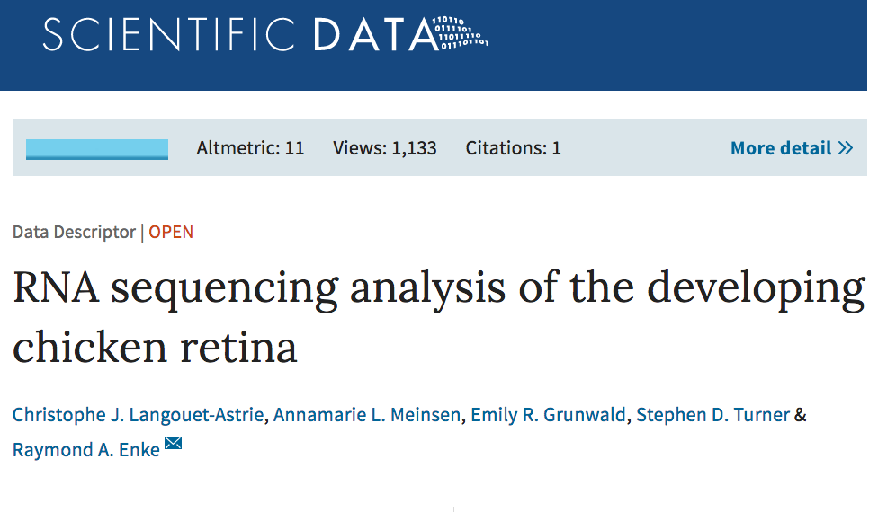
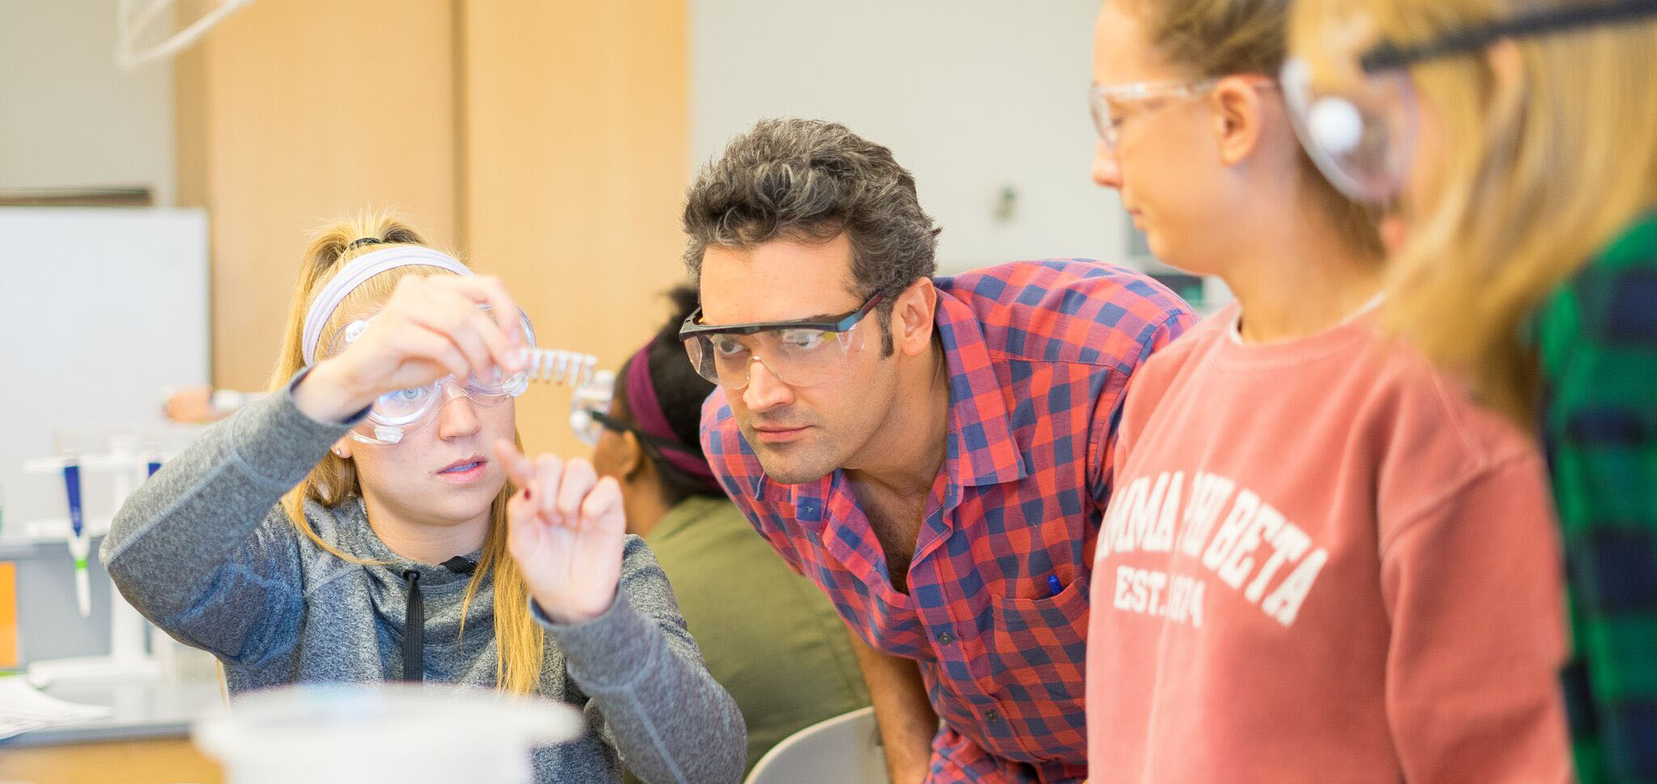
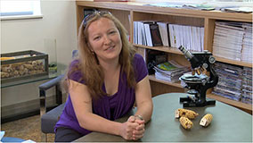
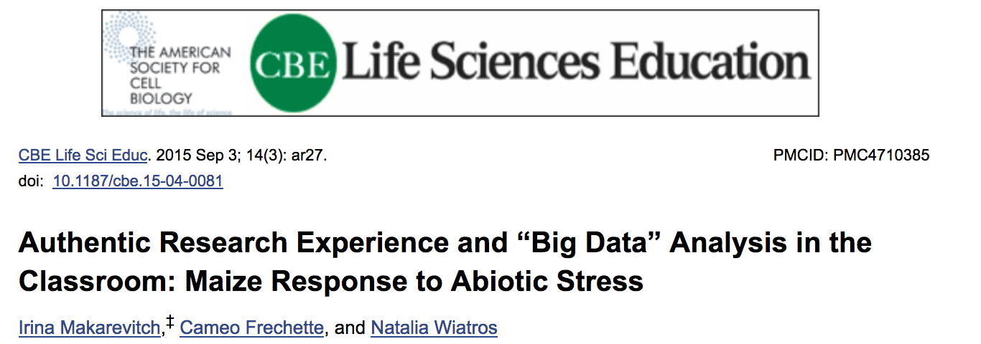
Support for Course-Based Research Experiences

Slide 18

Bisque
Image analysis, management, and metadata
Secure image storage, analysis, and data management
Integrate existing applications or create new ones
Custom visualization and image handling routines and APIs
Notes:
Focus here is on genomics data, but not restricted to genomics data

Slide 19
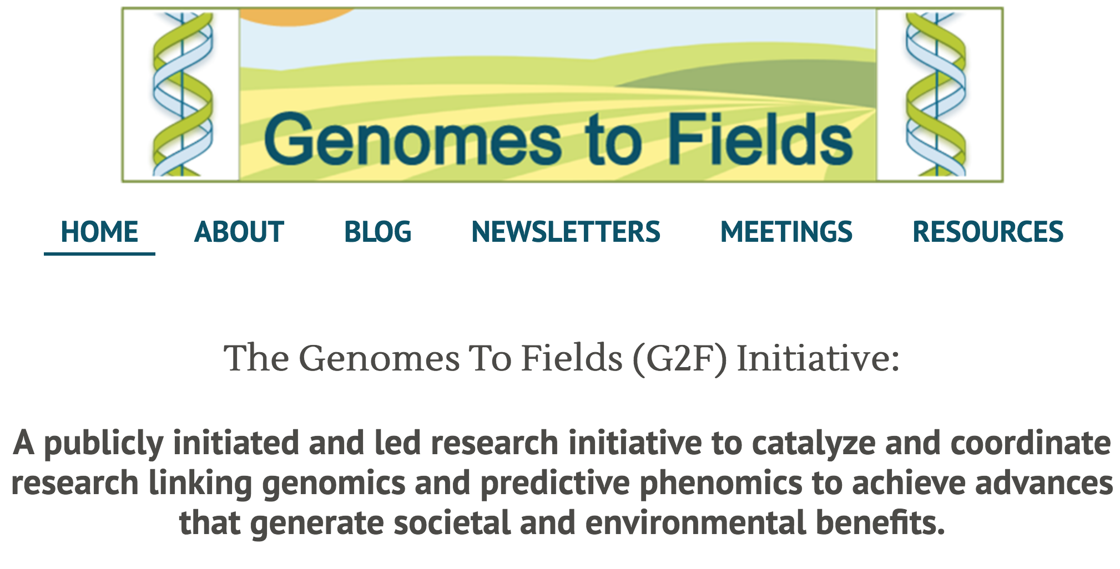

Image and GxE-driven collaboration

Slide 20
Future-focused mission goals
Enable data-driven discovery:
Enable “deep” data integration and analysis
Support sophisticated data expeditions defined by users or user groups
Foster interoperability across computational resources and platforms:
Deliver CyVerse as a self contained platform to public and private sector entities
Encourage ”Powered by CyVerse
Align with other resources: Amazon, Google, NIH Commons, many other federal projects.
Train the next generation of data scientists:
Develop a sophisticated workforce for academia and industry

Slide 21









CyVerse Institutions
CyVerse is a collaborative virtual organization
CyVerse UK

